Slide 1
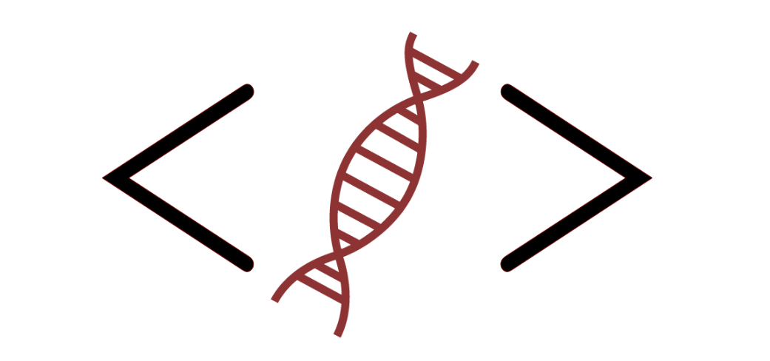
Bioinformatics Bootcamp
Biomedical Machine Learning with Python
PART II: Machine Learning for Biomedical Applications
Module 12: Image Processing Adv. Topics

Slide 2
Contact Info
Daniel Montemayor Ph.D.
Assistant Professor / Research
Center for Renal Precision Medicine
Department of Medicine
UT Health San Antonio
Email: montemayord2@uthscsa.edu
Office hours: https://calendly.com/daniel_montemayor/montemayor-office-hours

Slide 3
Part II : Overview
Getting to know your data
Formatting | Visualization | Partitioning | Normalization | Integrity
Feature Selection
Parsimony | Dimension Reduction | Supervised and Unsupervised Methods
Classification Models
Cross-Entropy and other Error Metrics | Random Forest | Logistic Regression
Regression Models
Linear Regression | Regularization | LASSO | Elastic-Net
End-to-End ML Workflow – Leukemia Project (two weeks)
Image Processing - Convolutional Neural Networks
Adv. Topics – Back propagation|vanishing gradient| Unet

Slide 4
Segmentation Recap
Histogram based Segmentation
Use image intensity to classify
Semantic Segmentation
Use calculated pixel features to assign a class to each pixel.
Image Classification
Learn useful features automatically to do classification
Notes:
-future resources – books. Digitalsereeni,

Slide 5
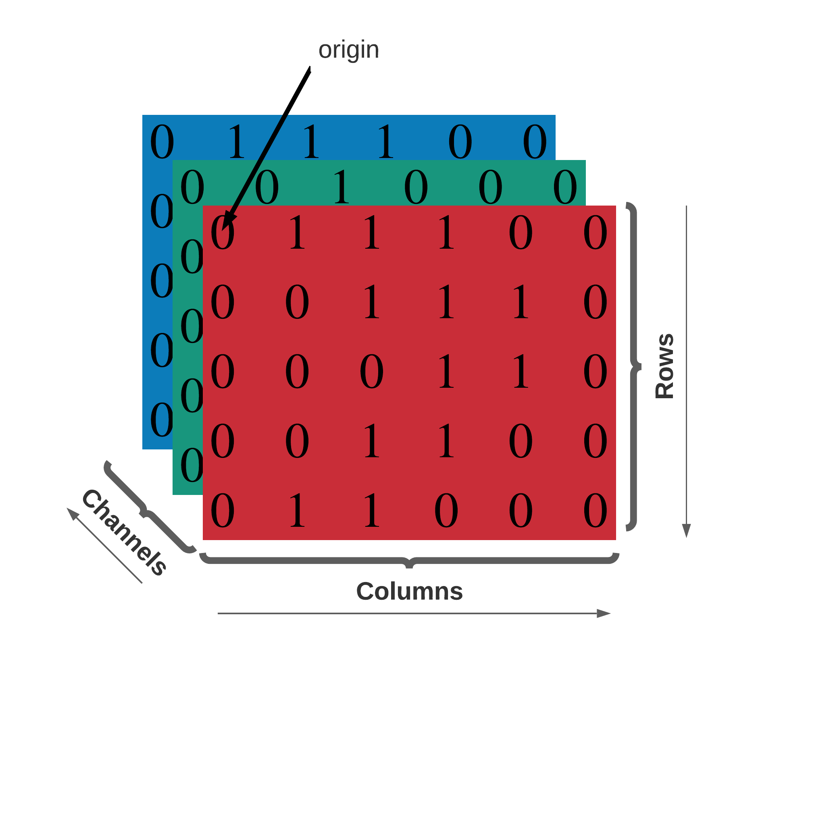
Formatting Recap
Scikit-image uses NumPy to represent images as ndarrays
2D grayscale: [row, col]
2D multichannel: [row, col, chan]
3D grayscale: [plane, row, col]
3D multichan: [plane, row, col, chan]
Developing convention for time
2D grayscale video: [t, row, col]
3D multichan video: [t, pln, row, col, ch]
Note cartesian convention (x, y, z) translates to [col, row, plane]

Slide 6
Convolutional Nets Recap
Quantify useful features in image to do classification.
Major features
Convolutional layers
Pooling layers
Fully connected layers

Slide 7
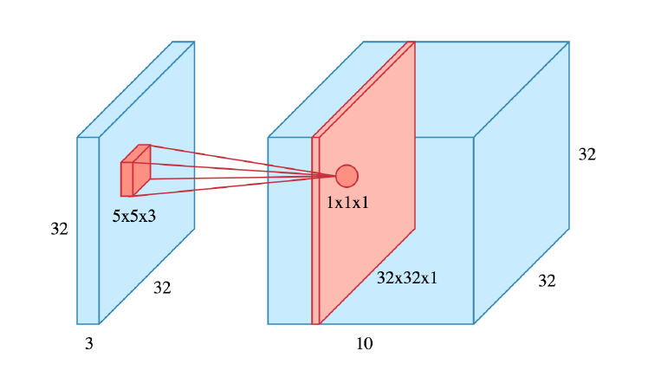
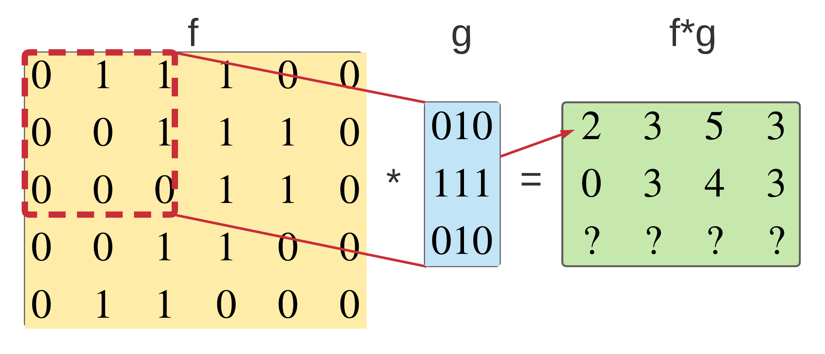
Convolutional Nets Recap
Color Image
Convolutional Layers
Learn 10 (5x5) convolutions

Slide 8
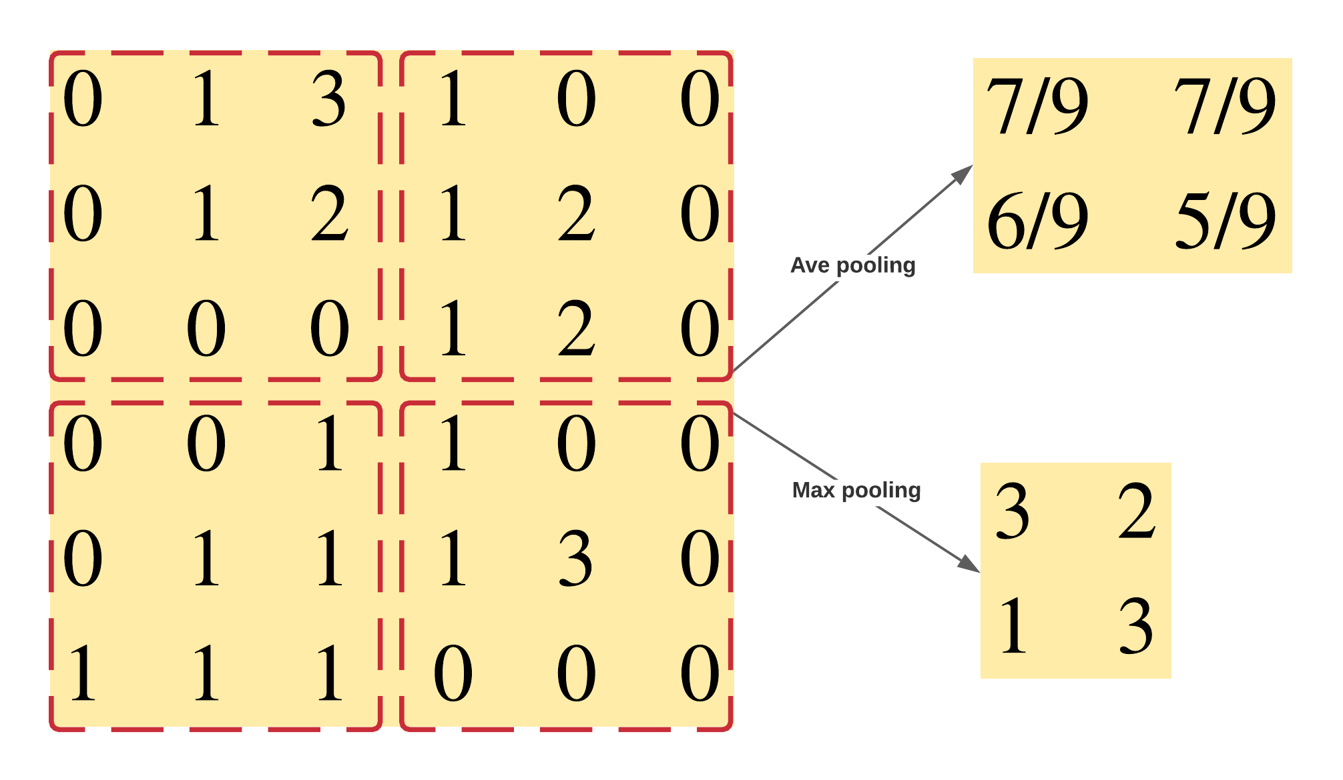
Convolutional Nets Recap
Pooling Layers
Ave pooling can do dimension reduction
Max pooling can also do denoising

Slide 9
Convolutional Nets Recap
Example CNN model for classifying MNIST handwritten digit dataset

Slide 10
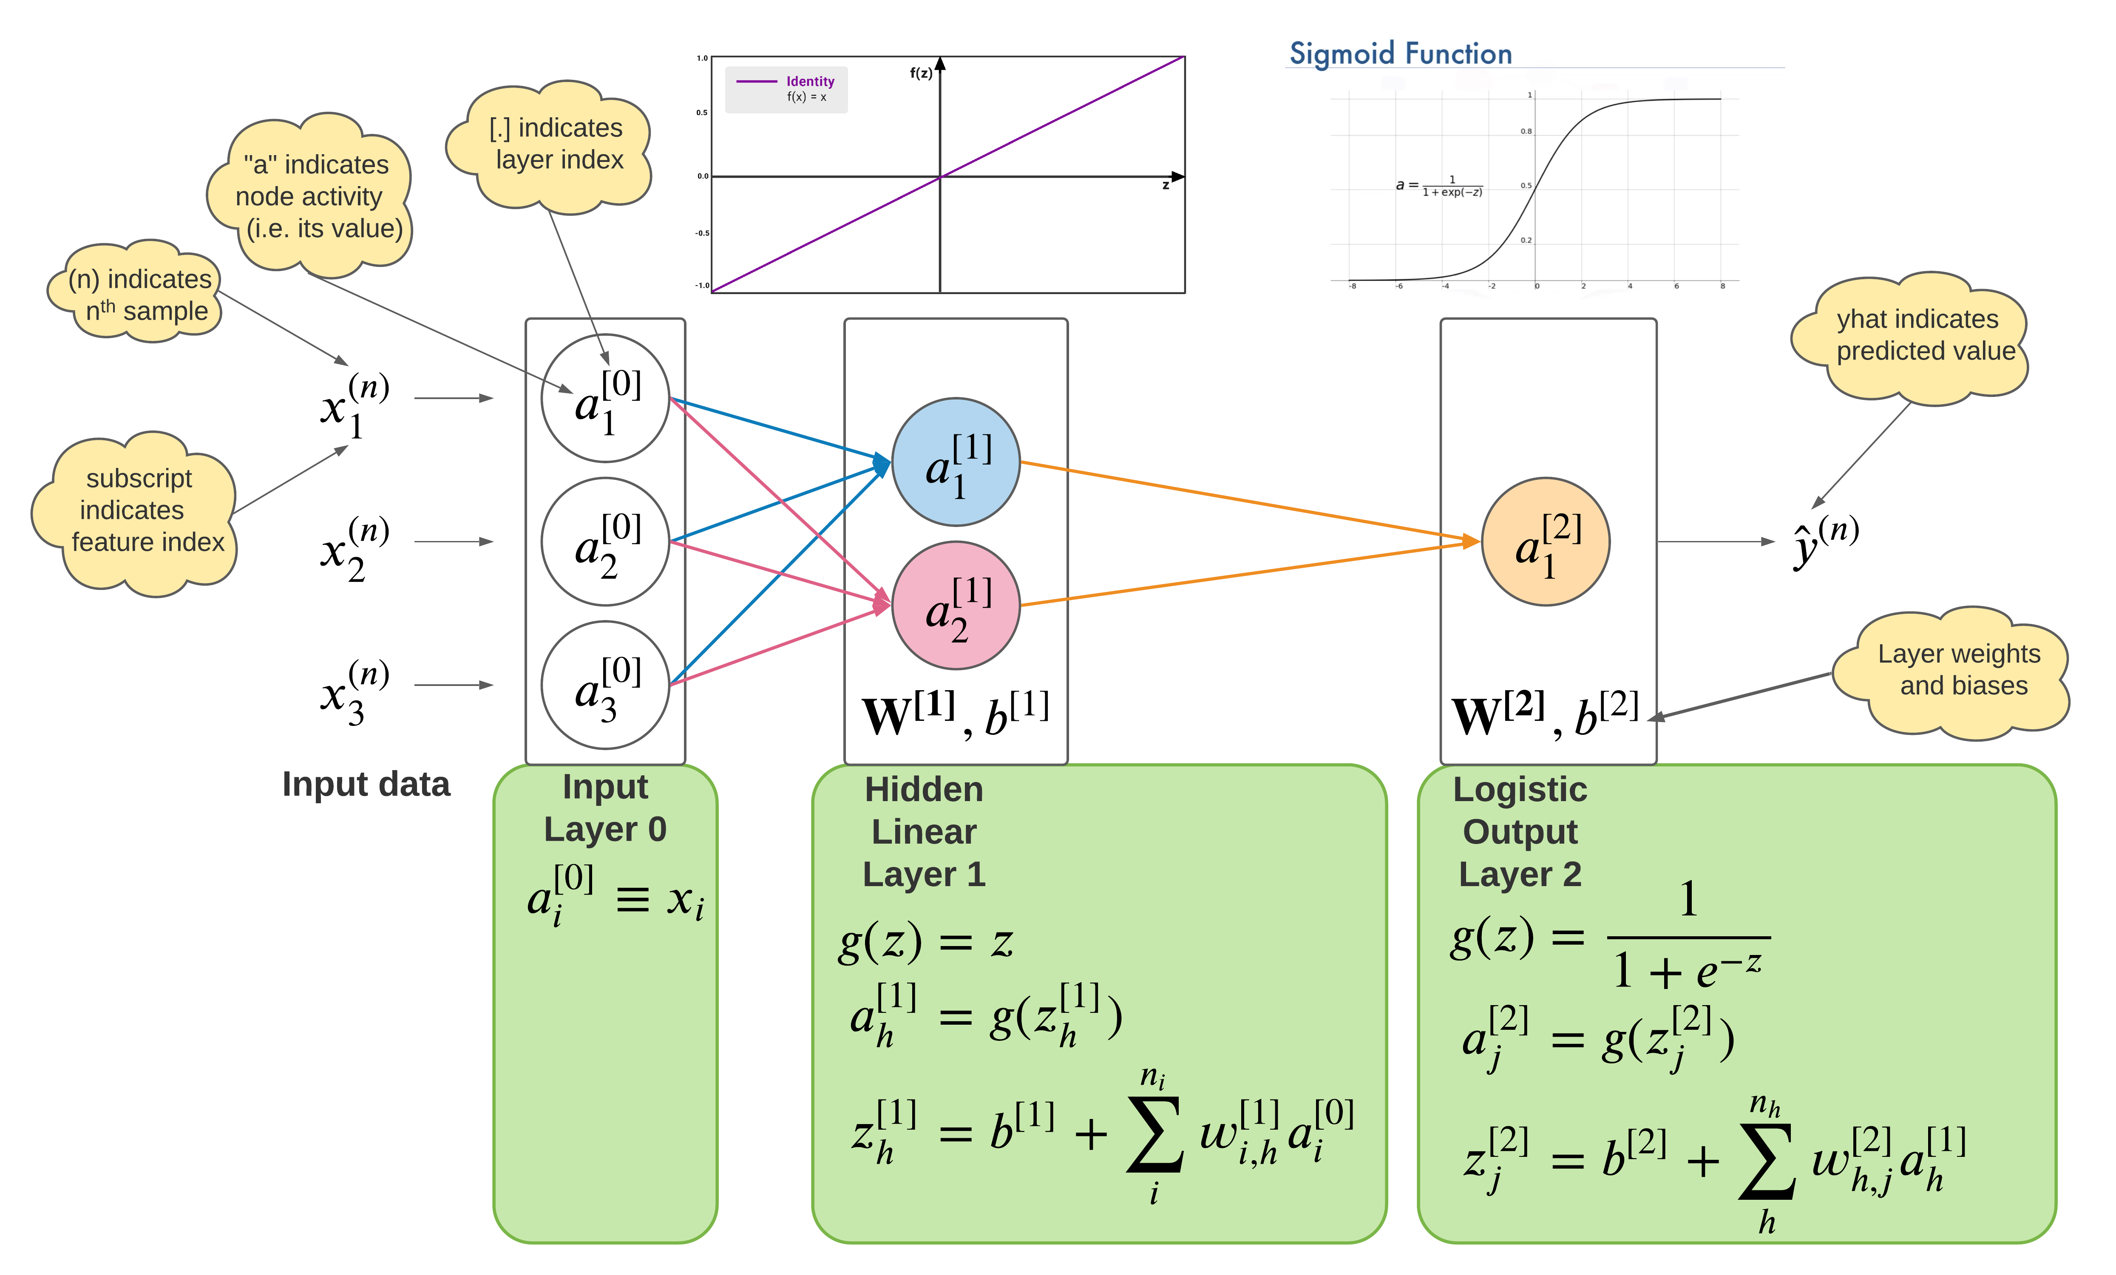
Prediction by Forward Propagation

Slide 11
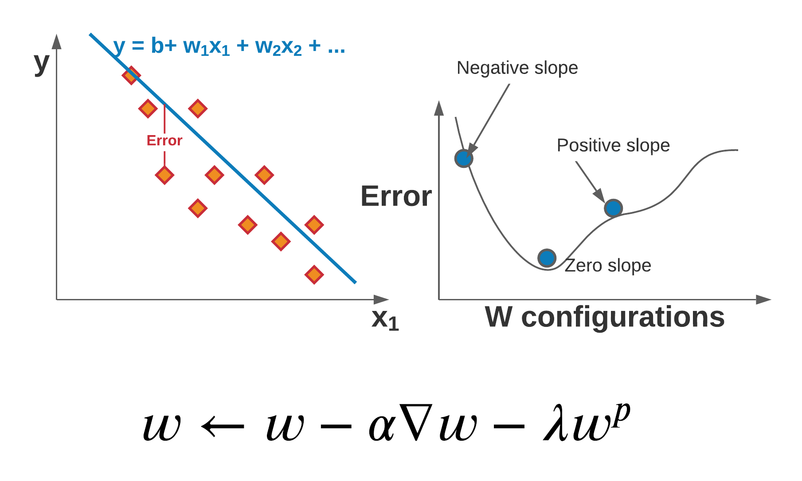
Recall Gradient Decent

Slide 12
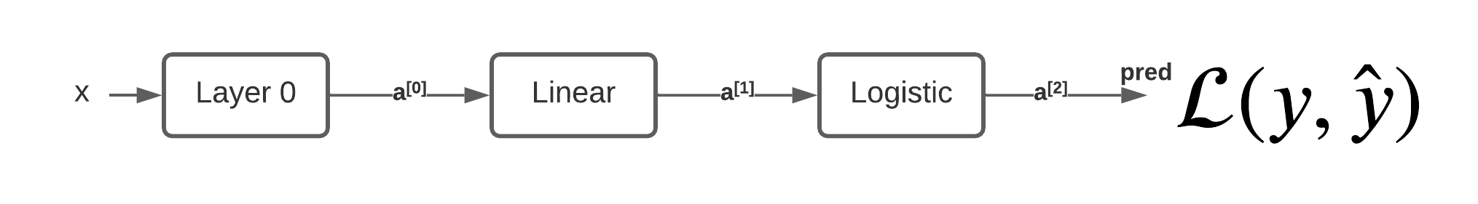
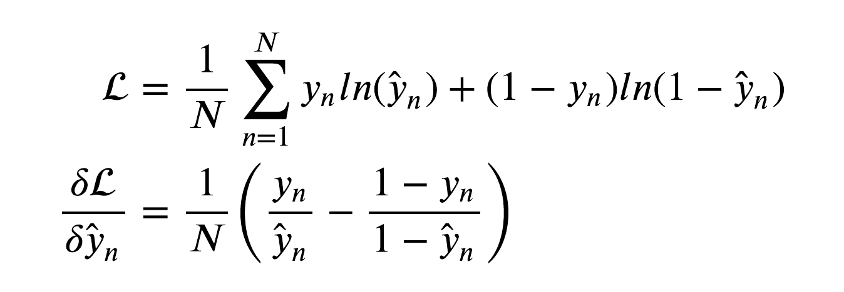
Binary Cross Entropy Error
We need to find the derivative of the Loss (error) with respect to each weight and bias!

Slide 13
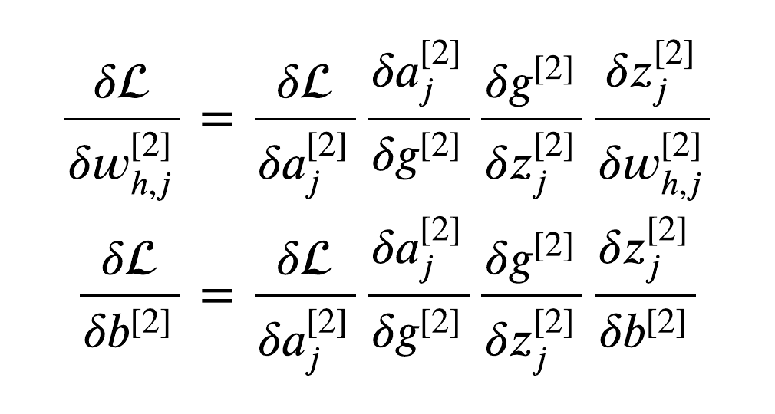
Deep Learning by Back Propagation
Use chain rule to solve for the derivative w.r.t. weights and biases in top layer.

Slide 14
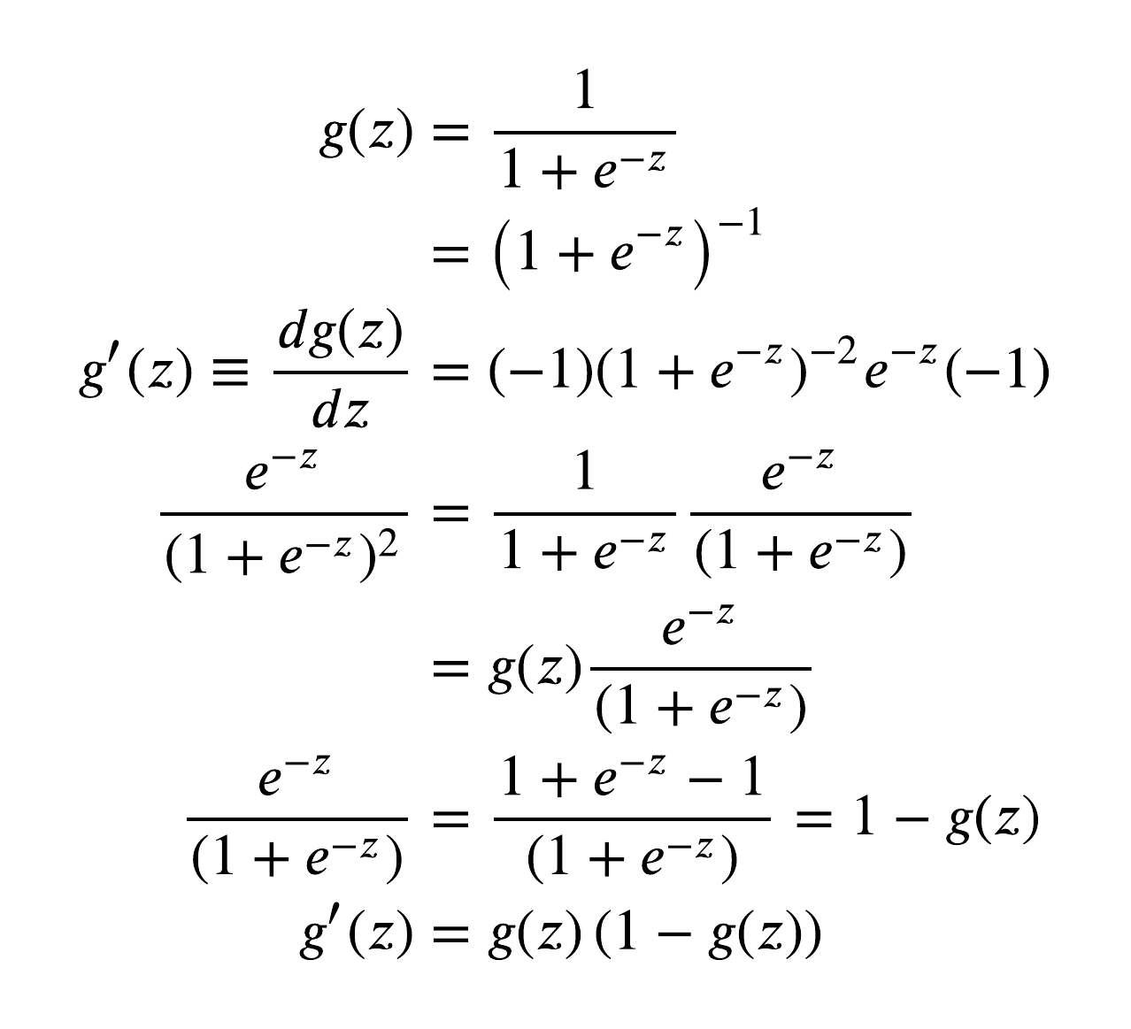
Deep Learning by Back Propagation
Logistic function
Use chain rule to solve for the derivative w.r.t. weights and biases in top layer.

Slide 15
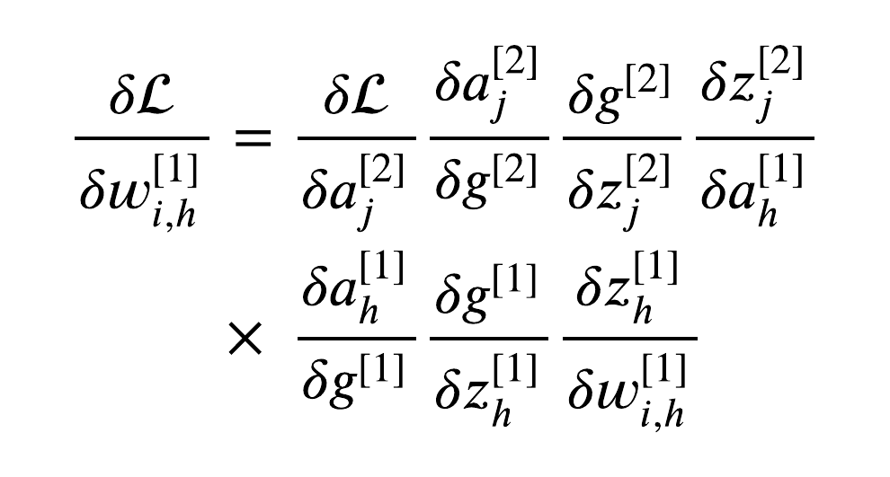
Deep Learning by Back Propagation
Use precalculated values to compute gradients in lower layer
Continue process to solve for the derivative w.r.t. weights and biases in hidden layer.

Slide 16
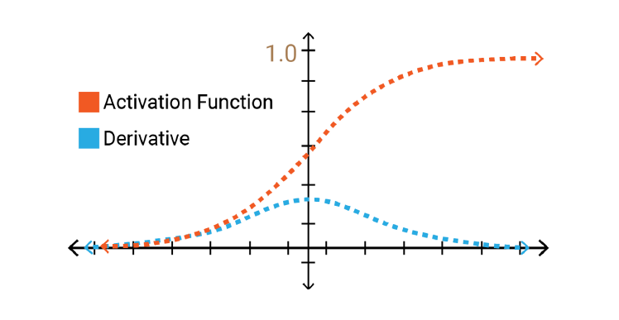
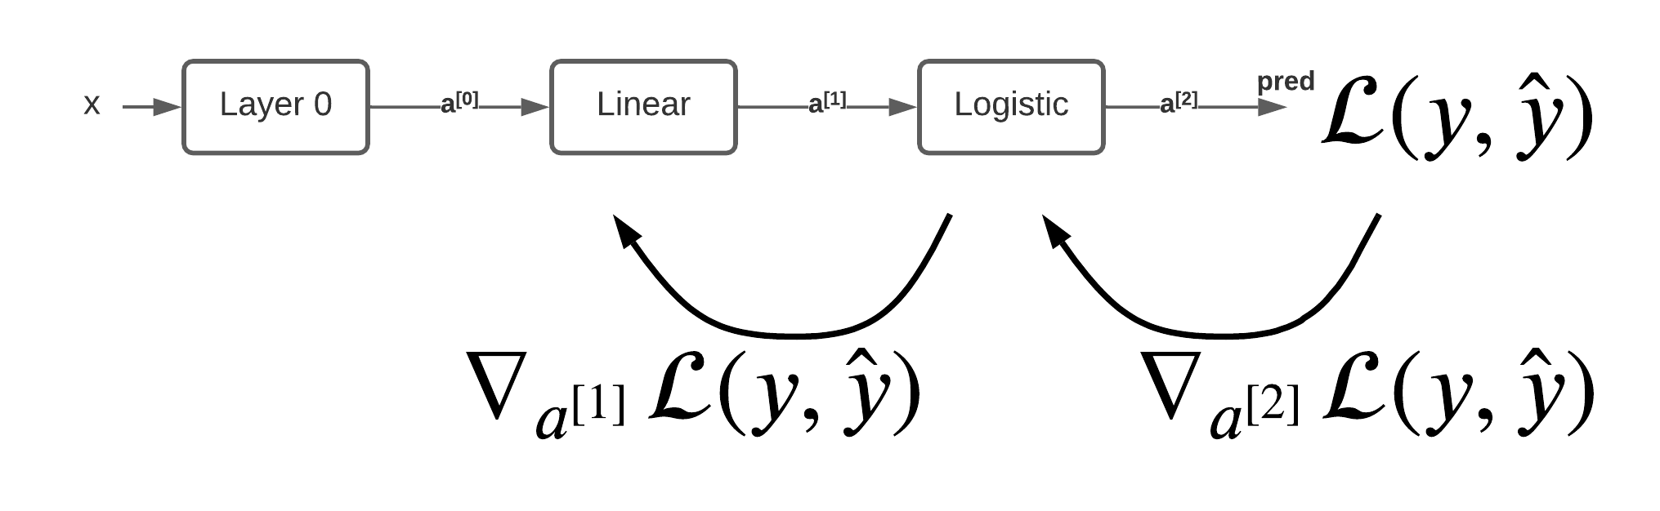
Vanishing gradient

Slide 17

Unet: Convolutional Networks for Biomedical Image Segmentation
Spatially rich data
Feature rich data
Horizontal links mitigate vanishing gradients
source: https://lmb.informatik.uni-freiburg.de/people/ronneber/u-net/

